Slide 1
Facial Expressions and Gaze in Conversational Agents (Furhat)
MLT Master’s Program – Language Technology – Dialogue Systems Course 2- LT2319 – Final Project

Slide 2
Table of Contents
1
3
2
4
Dialogue Samples and Demo
Introduction
Methodology
Discussion and Future Work

Slide 3
Introduction
About the project
For this course, I wanted to experiment with multimodality in conversational agents capable of producing gaze coordination and/or facial expressions. The work is focused on implementing eye movement and facial gestures on Furhat.

Slide 4
Why?
- Curious on how to use a multimodal conversational agent.
- The “hidden” meaning behind facial gestures. How do they improve the dialogue and our social interactions?
- Could a robot mimic human behavior?

Slide 5
How?
- SDK Launcher for Furhat from the developer zone.
- Furhat’s Remote API – API documentation
- Swagger Editor
- Structured the project on the pre-existing code from Lab-3.

Slide 6
Methodology
1
2
3
Data collection:
Literature
Daily real-time observations of human dialogue (verbal 2-party communication)
Video Recordings

Slide 7
Literature
More insight on human facial expressions:
- Paper: Social and emotional functions in facial expression and communication: the readout hypothesis
- Book: Understanding Facial Expressions in Communication
Cross-cultural and Multidisciplinary Perspectives
(Facial Expressions to Emotions: A Study of Computational Paradigms for Facial Emotion Recognition by Dipti Deodhare & Study of Facial Micro-expressions in Psychology by Braj Bhushan)

Slide 8
Observations
S1: Do you think we have class on Wednesday? (Head tilt/roll movement of the head, wrinkling nose, frowned eyebrows)
S2: Mmm, no, I don’t think so. (Shanking head movement, lips forming a frown (∩).
S1: (backchannel) (expression of relief, relaxed face and jaw, also signs). Good, good (nodding).
S2: But ah (filler, eyes looking up) we do have a zoom meeting in the morning! (Nodding, eyebrows raised, eyes widened).
S1: (listening with eyebrows frowned, looking down and up to U1.)

Slide 9
Recordings
S1: Hey Mark! (Widened eyes, brows raised, big smile). How are you? (big smile)
S2: Oh (surprised expression) Sarah! Nice to see you here! (very small movements of the head, almost like nodding). Eh! You know the usual, (head tilt to one side, wrinkling nose, narrowed eyes/frowned eyebrows, also might avoiding eye gaze) work! How about you? (Raise eyebrows, smile).
S1: I got the job interview! (enthusiastic)….
S2: (overlapping/backchannel), Oh! Congratulations! (Widened eyes, expression of surprise).
S1: … thank you! (Nodding / acknowledging the comment) And I’ve also been traveling a lot. (Head nodding, enthusiasm).
S2: Oh! (backchannel) (surprised expression).

Slide 10
Implementation

Slide 11
Tools
- SDK Launcher for Furhat from the developer zone.
- Furhat’s Remote API – API documentation
- Swagger Editor
- Structured the project on the pre-existing code from Lab-3.
- Programming Languages: Typescript (xstate library)
- processed utterances through chatGPT based on 2 different prompts:
1. “Continue the story from the following sentence:”
2. “Extract the important information from the following sentence:”

Slide 12
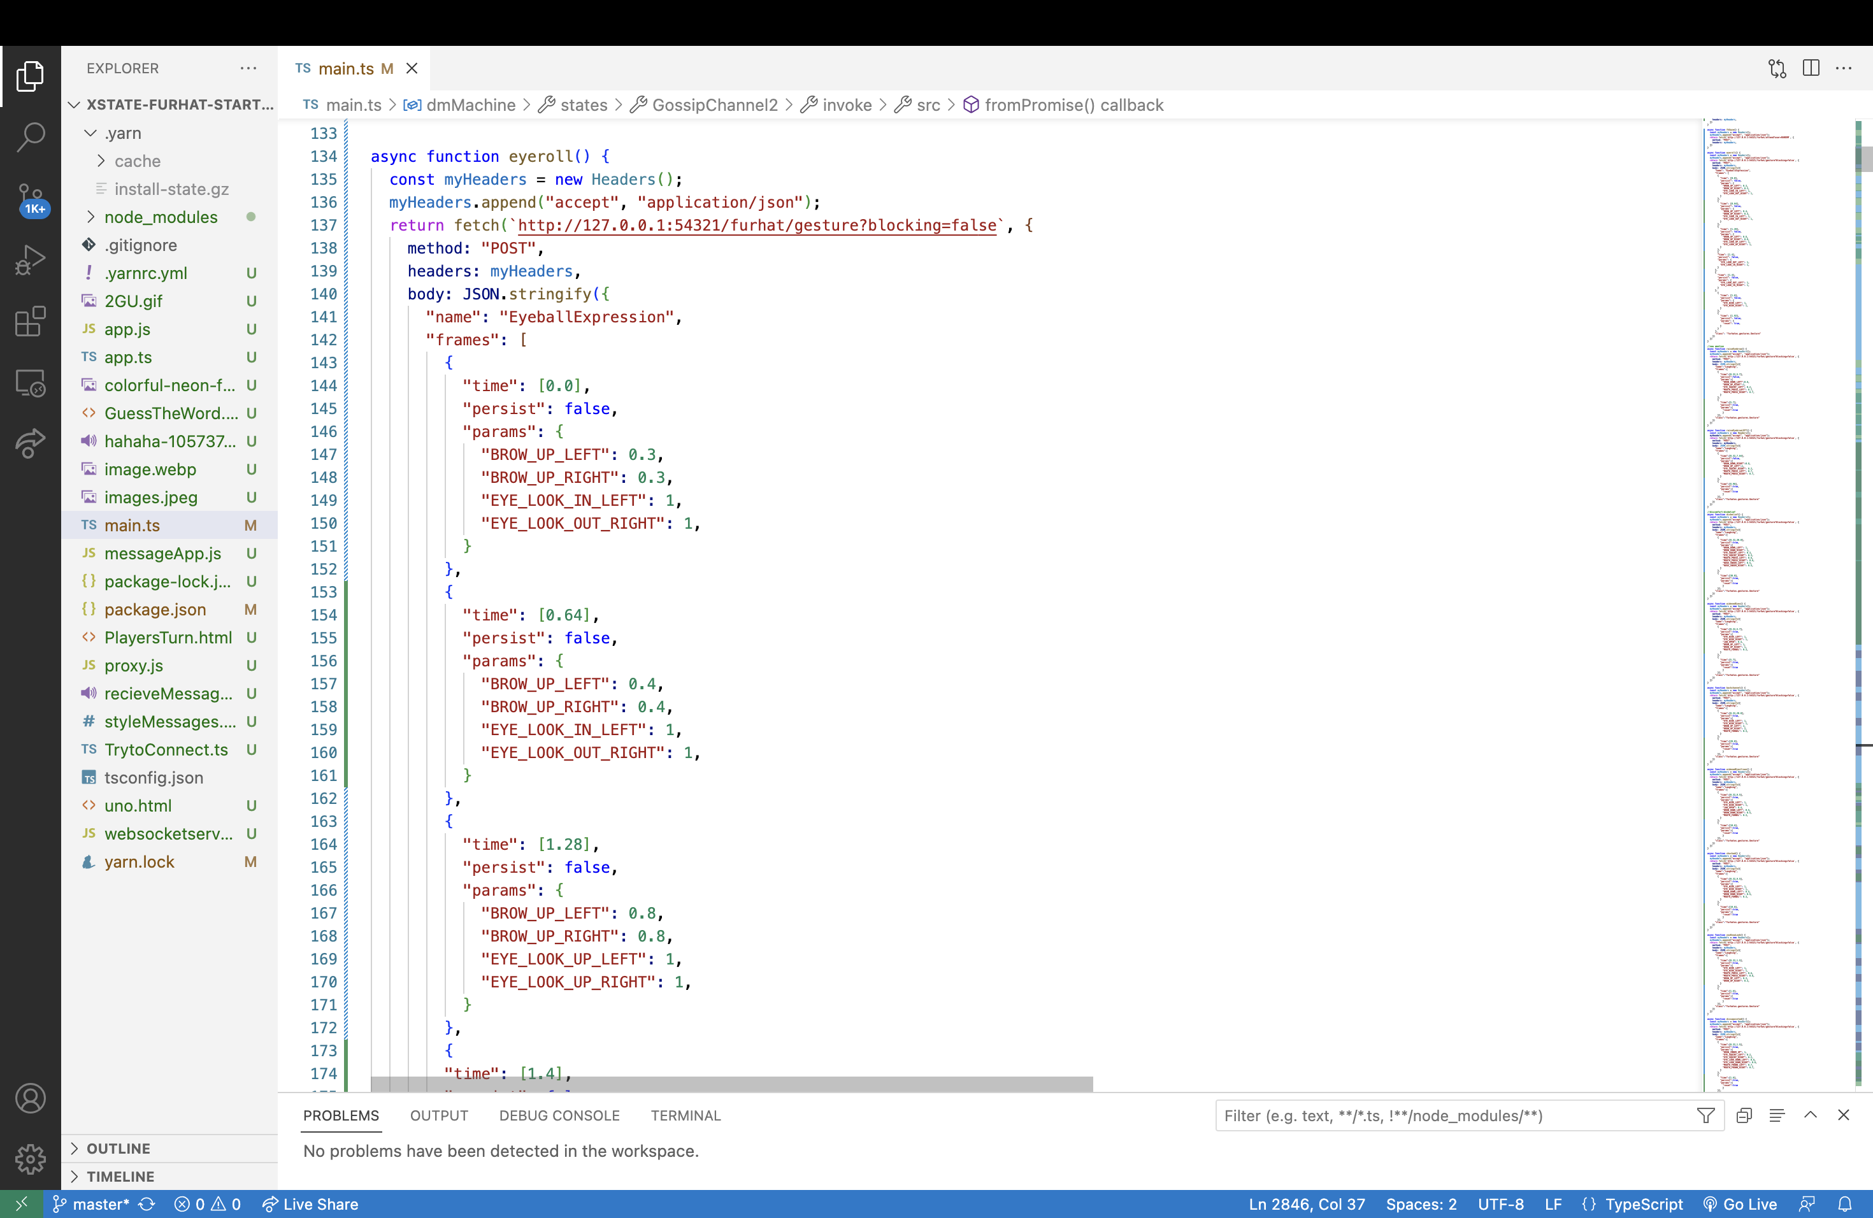
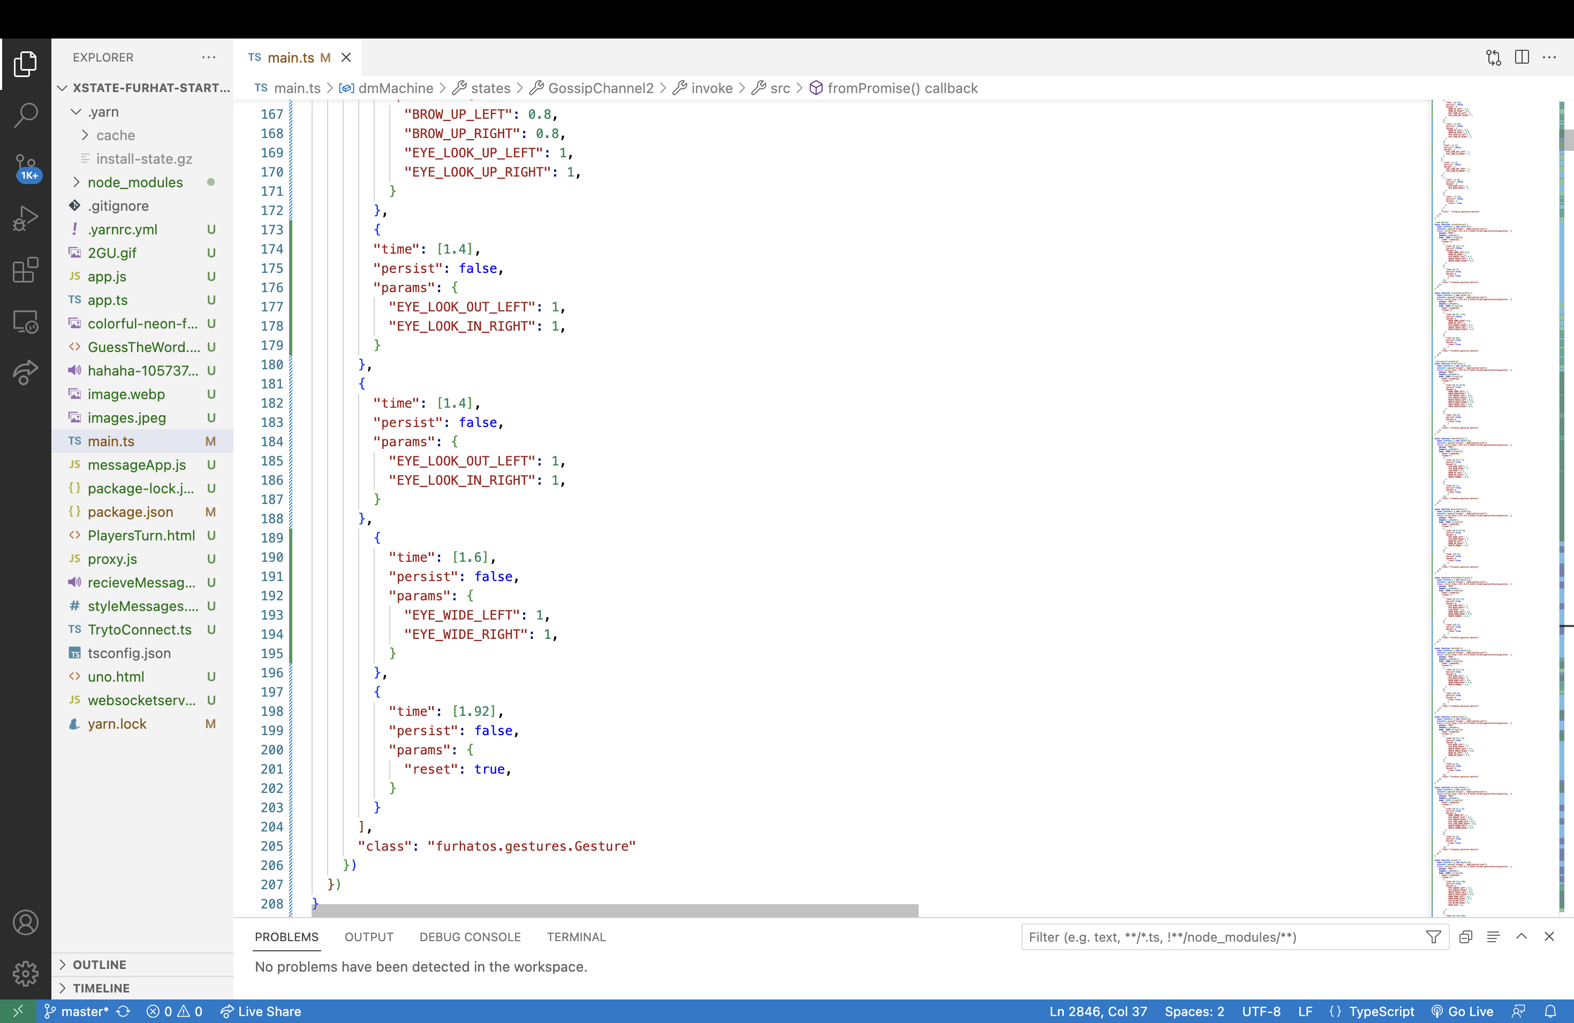
Furhat and Dialogue
I divided the implementation process into 3 categories:
A. Creating the functions for facial expressions and eye movements

Slide 13
Furhat and Dialogue
I divided the implementation process into 3 categories:
B. Creating the dialogue states:
- implementation of 2 scenarios: A. coffee meet up, B. creating spooky stories.
- Implementation of different states according to user’s phycological current state.
- implementation of backchannels and confirmation utterances.

Slide 14
Furhat and Dialogue
I divided the implementation process into 3 categories:
C. Combining the two and figuring out smooth transitions.
A little bit more challenging because:
- create new entire states just for the facial gesture
- altering the durations of the functions

Slide 15
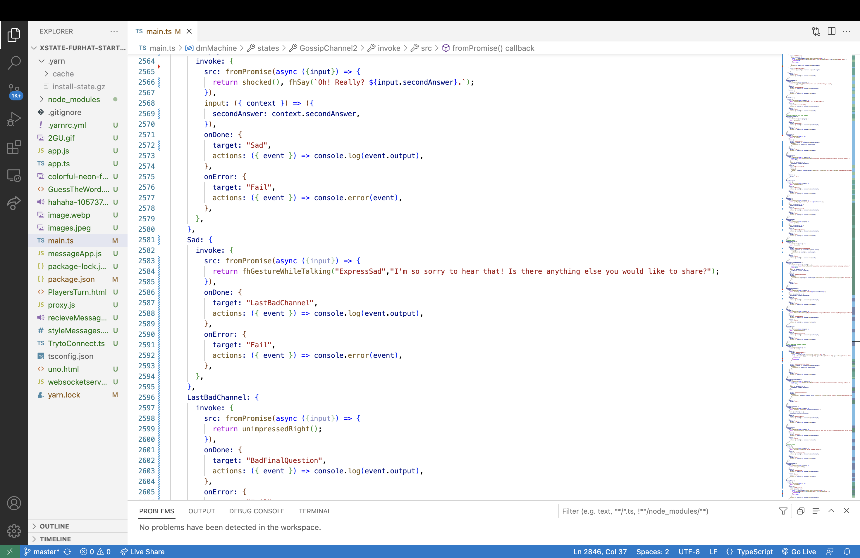
An example:

Slide 16
Examples of implemented Dialogue
A small example:
User: Hey! Long time no see! How’re things?
Furhat: Me? *eyes widened*, Oh! *relaxed* I could say I had a rather eventful day! Your?* smile avoiding direct eye contact *
Furhat (listen state): *raising one eybrow*
User: inaudible
Furhat: *moving head left to right - ”no/denial” head movement* Hmm! I'm sorry I didn't hear the last part! What did you say?

Slide 17
Examples of implemented Dialogue
And another one:
Furhat: (listen state) *disbelief*
User: *presents a short sentence to continue the story*
Furhat : *eyeroll*
Furhat : *raising one eyebrow* Hmm!
Furhat : *shocked expression* *continues story from user’s previous sentence*

Slide 18
Towards Success
- Successful implementation of gaze coordination
- Successful implementation of facial expressions according to conversational context:
- the system can detect key words that indicate the right use of emotion according to speakers' intention.
- successful implementation of backchannels and confirmation utterances (eh?).
- good implementation of laughter (voice is an issue).
- overall: A decent example of a “realistic” conversation.

Slide 19
Limitations and Difficulties
Too many ideas – too little time
LLM’s are not made for dialogue
I tried, but unfortunately failed, to add audio sounds in laughter states.
I tried to connect it with other frontend applications – more interactive gameplay, for example.

Slide 20
Future Work
More real-time observations – wider variety
Collect more data on human-human interaction focusing on facial gestures and eye movement
Deeper research on facial gestures and when each is more appropriate than the other.
Adjust facial gestures and dialogue to speaker’s
Better understanding of speaker’s facial expressions
Improving voice – pitch, intonation, tone, etc.…

Slide 21
You can find everything on my git repo:
https://github.com/vladmaraev/xstate-furhat-starter/pull/2

Slide 22
Refences
Maraev Vladislav, Howes Christine, Mazzocconi Chiara, Pelachaud CtherineTowards. 2023. Investigating Gaze and Laughter Coordination in Socially Interactive Agents. University of Gothenburg, Sweden.
Buck, Ross. 1994. Social and emotional functions in facial expression and communication: the readout hypothesis.University of Connecticut, USA.
Understanding Facial Expressions in Communication: Cross-cultural and Multidisciplinary Perspectives. A book collection of research papers from various authors. Editors: Manas K. Mandal, Avinash Awasthi. 2015. Springer.
SDK Launcher for Furhat. Access Link: https://furhat.io
Remote API Documentation for Furhat. Access Link: https://docs.furhat.io/remote-api/#gesturedefinition

Slide 23
Thanks!
Please keep this slide for attribution

